Slide 1
Microsoft azure
2015 Intern Class
Michael Fazio
Software Engineer
Custom Software
Notes:
This is the cover slide only, do not use for internal pages. Presenter email, Twitter handle or other info can be added beneath the name if desired.

Slide 2


What is the cloud?
Notes:
In the simplest terms, cloud computing means storing and accessing data and programs over the Internet instead of your computer's hard drive.
The cloud is just a metaphor for the Internet.
Collection of servers

Slide 3
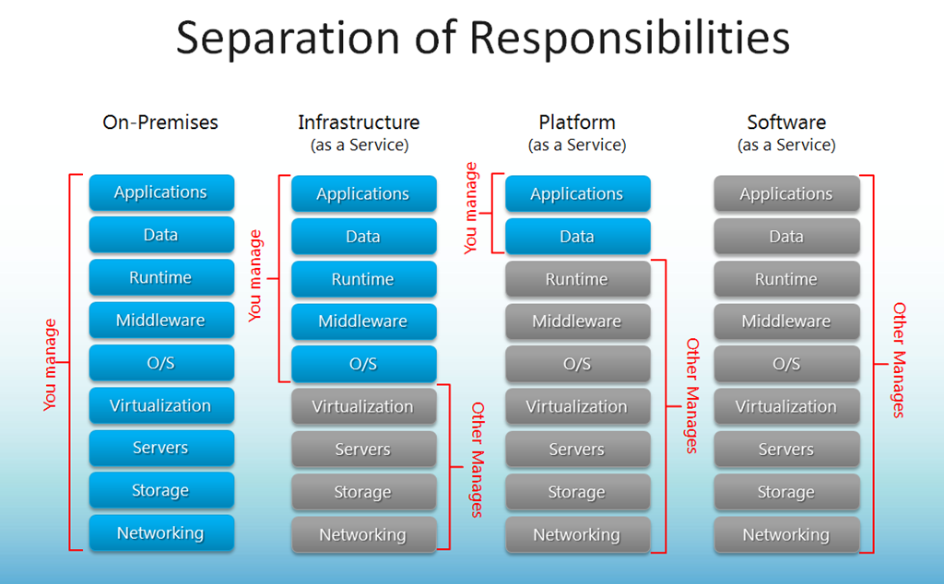
IAAS…PAAS…SAAS…WHA?
Notes:
IAAS – Azure Virtual Machines
PAAS – Web Apps, Azure SQL
SAAS – Office 365
Also:
IAAS – Amazon Web Services
PAAS – Google App Engine
SAAS – Gmail

Slide 4
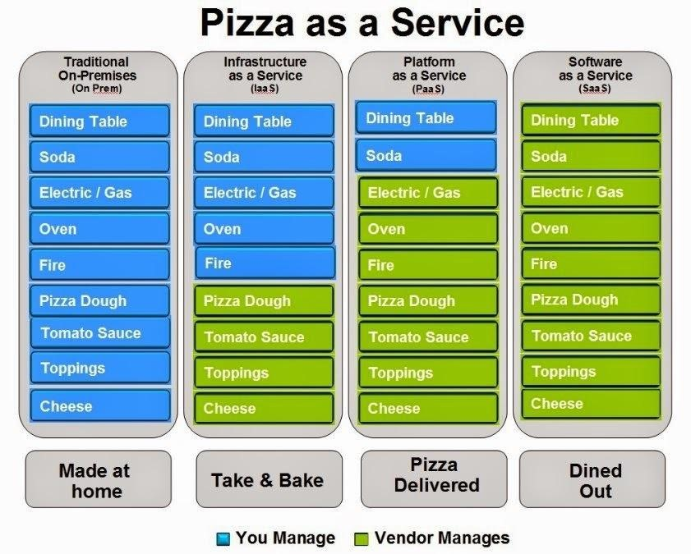
PAAS…Pizza as a service

Slide 5
What is Azure?
According to Microsoft….
“Azure is Microsoft’s cloud computing platform, a growing collection of integrated services—analytics, computing, database, mobile, networking, storage, and web—for moving faster, achieving more, and saving money.”

Slide 6
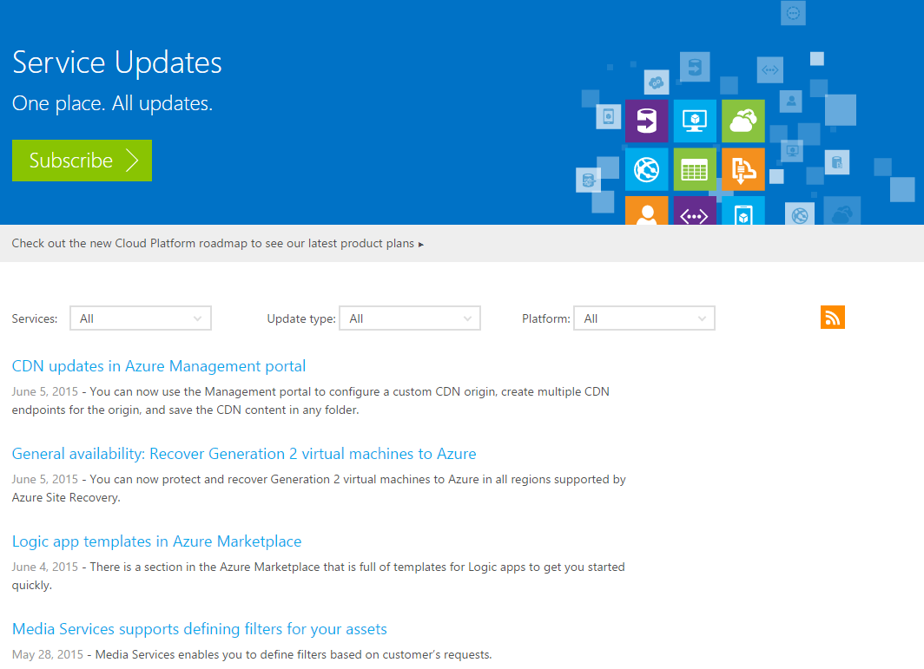
Azure updates…a lot http://azure.microsoft.com/en-us/updates/
Notes:
Releases every three weeks
May break things

Slide 7
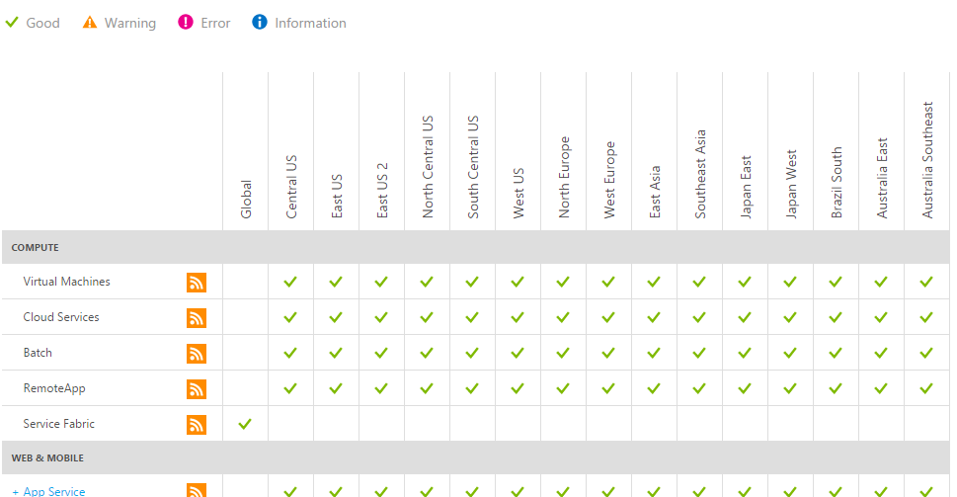
Azure Status http://azure.microsoft.com/en-us/status/

Slide 8
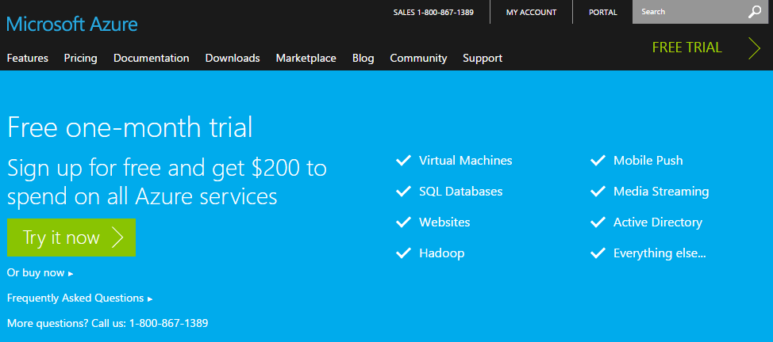
Free TRIAL http://azure.microsoft.com/en-us/pricing/free-trial/

Slide 9
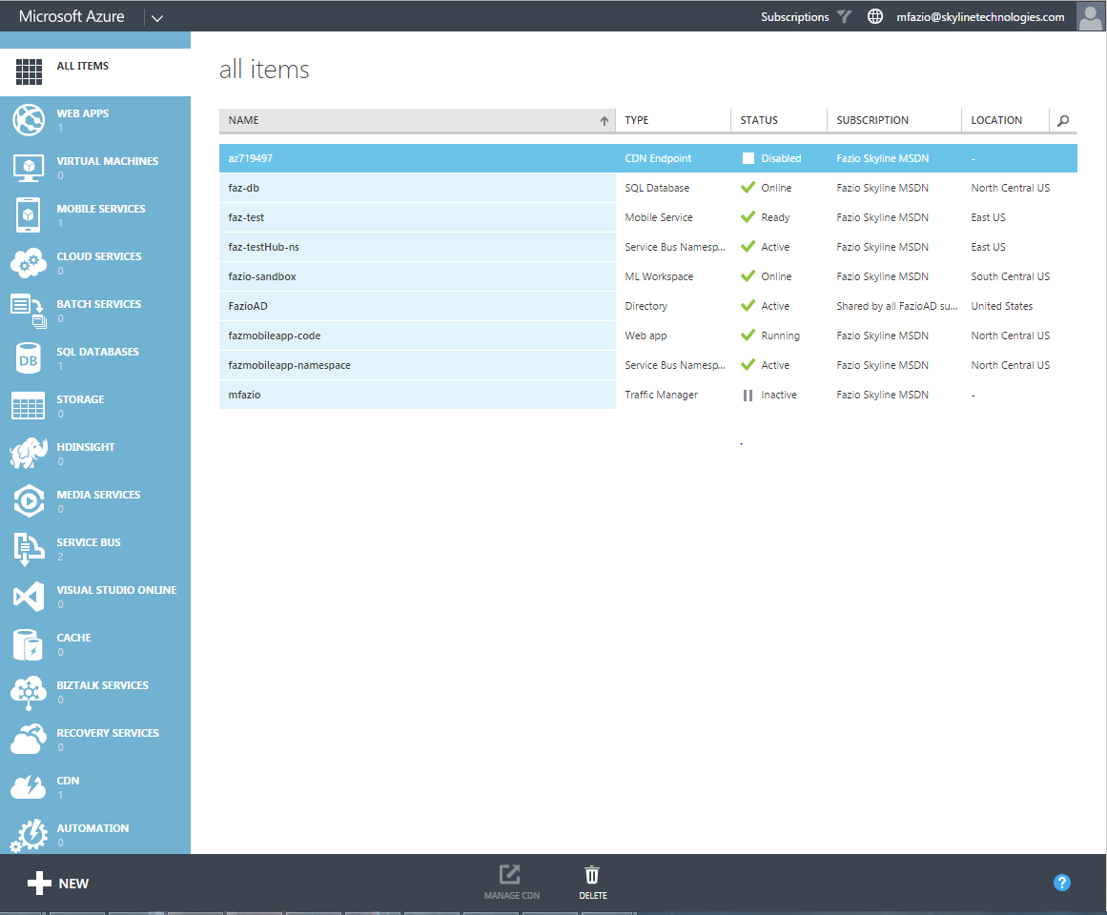
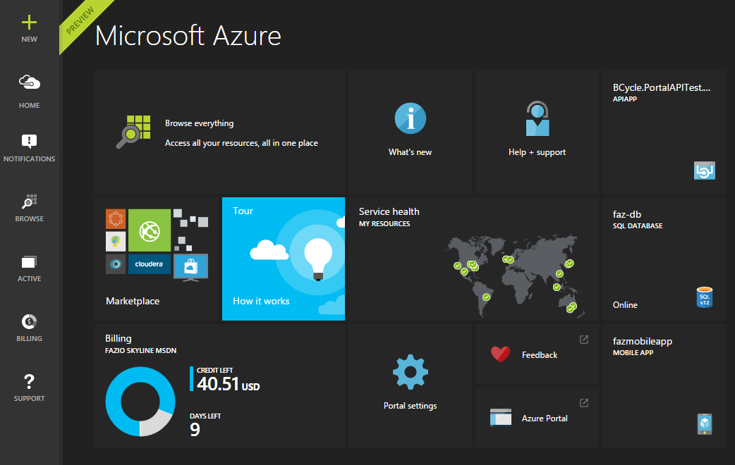
THE AZURE PORTAL(S?)
Microsoft Azure Management Portal
https://manage.windowsazure.com
Microsoft Azure Preview Portal
https://portal.azure.com
Notes:
Can also manage through:
Visual Studio
PowerShell

Slide 10
Management Portal https://manage.windowsazure.com/
Notes:
Traffic Manager

Slide 11
Preview Portal https://portal.azure.com/
Notes:
More detailed permissions
Trek account

Slide 12
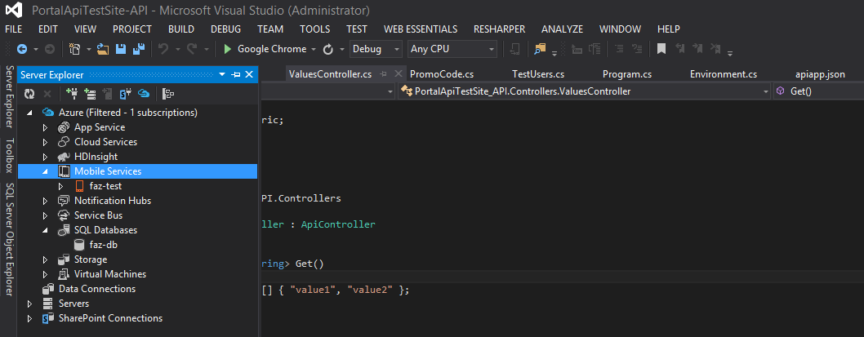
Visual Studio

Slide 13
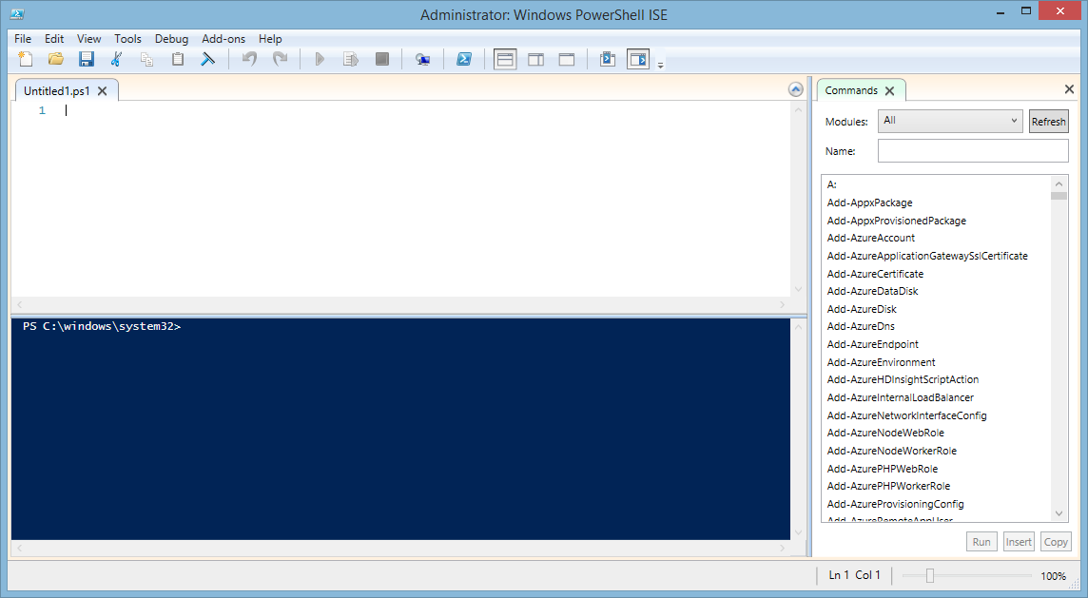
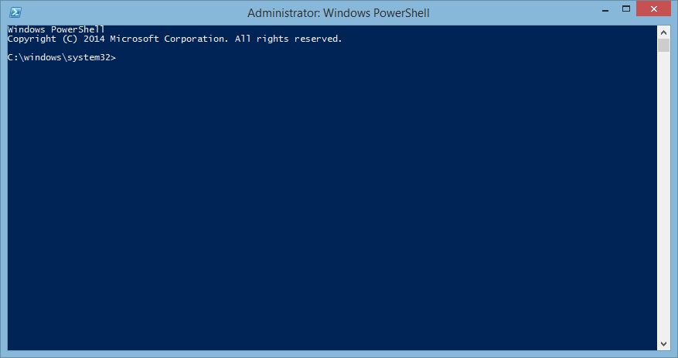
PowerShell
Notes:
Will be available in Visual Studio

Slide 14

BLUE SUN CORPORATION
Notes:
Need to see if we can move stuff to Azure
Basic sites to test functionality

Slide 15

Basic Web APP
Notes:
No DB connectivity
Steps – Visual Studio
Open VS2013 (if possible)
New Project…
Installed > Templates > Visual C# > Web > ASP.NET Web Application
MVC App (or Empty is actually fine)
Check “Host in the cloud” as a Web App
Configuration settings
Steps – portal.azure.com
NEW
Web Apps
Web App
URL, App Service Plan, Pricing Tier
Bring External Domains (Custom Domain Assignment)

Slide 16
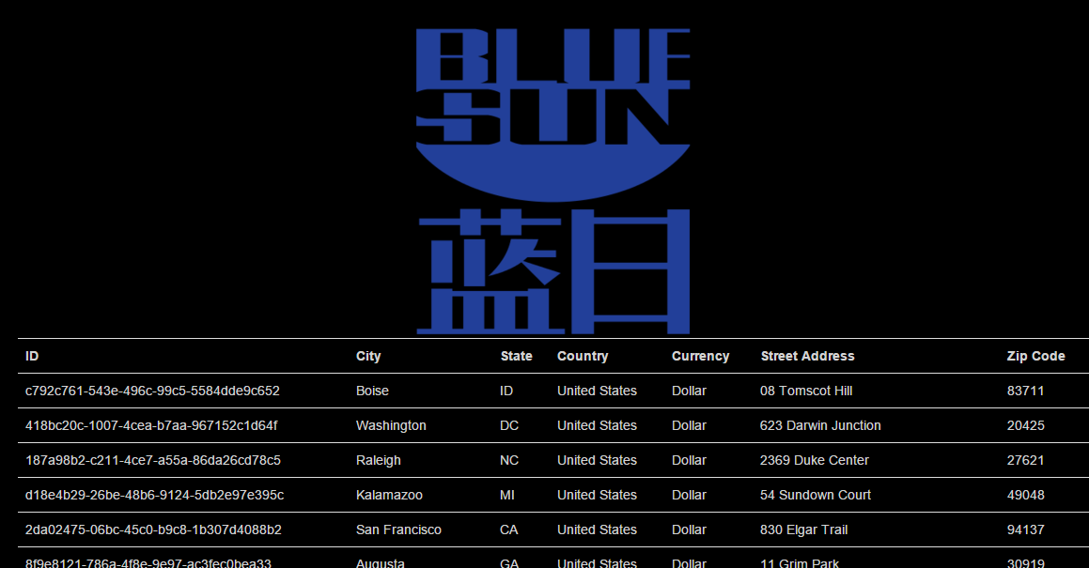
DB-Connected Web APP
Notes:
No DB connectivity
Steps – Visual Studio
Open VS2013 (if possible)
New Project…
Installed > Templates > Visual C# > Web > ASP.NET Web Application
MVC App (or Empty is actually fine)
Check “Host in the cloud” as a Web App
Configuration settings
Steps – portal.azure.com
NEW
Web Apps
Web App
URL, App Service Plan, Pricing Tier
Bring External Domains (Custom Domain Assignment)

Slide 17
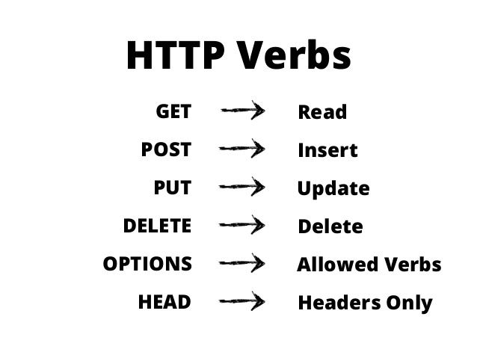
REST APIs
Notes:
No DB connectivity
Steps – Visual Studio
Open VS2013 (if possible)
New Project…
Installed > Templates > Visual C# > Web > ASP.NET Web Application
MVC App (or Empty is actually fine)
Check “Host in the cloud” as a Web App
Configuration settings
Steps – portal.azure.com
NEW
Web Apps
Web App
URL, App Service Plan, Pricing Tier
Bring External Domains (Custom Domain Assignment)

Slide 18
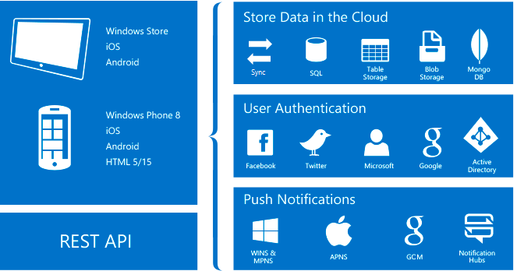
Azure Mobile API
Notes:
No DB connectivity
Steps – Visual Studio
Open VS2013 (if possible)
New Project…
Installed > Templates > Visual C# > Web > ASP.NET Web Application
MVC App (or Empty is actually fine)
Check “Host in the cloud” as a Web App
Configuration settings
Steps – portal.azure.com
NEW
Web Apps
Web App
URL, App Service Plan, Pricing Tier
Bring External Domains (Custom Domain Assignment)

Slide 19
API-Connected Web APP
Notes:
No DB connectivity
Steps – Visual Studio
Open VS2013 (if possible)
New Project…
Installed > Templates > Visual C# > Web > ASP.NET Web Application
MVC App (or Empty is actually fine)
Check “Host in the cloud” as a Web App
Configuration settings
Steps – portal.azure.com
NEW
Web Apps
Web App
URL, App Service Plan, Pricing Tier
Bring External Domains (Custom Domain Assignment)

Slide 21
References
What is Azure? - http://azure.microsoft.com/en-us/overview/what-is-azure/
Azure Status - http://azure.microsoft.com/en-us/status/
Azure Management Portal - https://manage.windowsazure.com/
Azure Preview Portal - https://portal.azure.com/
Installing Azure PowerShell - https://azure.microsoft.com/en-us/documentation/articles/powershell-install-configure/

